Slide 1

RNNs for Bitcoin Price Predictions Case Study
Department of Informatics
Master Degree in Computer Science
Machine Learning course
Francesco Peragine
f.peragine@studenti.uniba.it

Slide 2
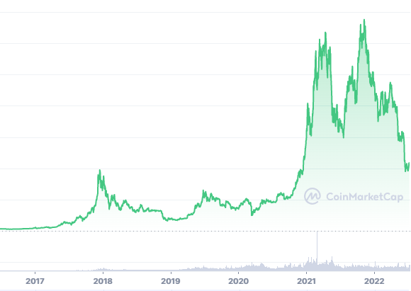
Why
Crescent interest
Public (governments, institutions)
Private (investors, traders, citizens)
Opportunities
Stock markets investments/speculations
Smart Contracts
NFTs
Blockchain

Slide 3

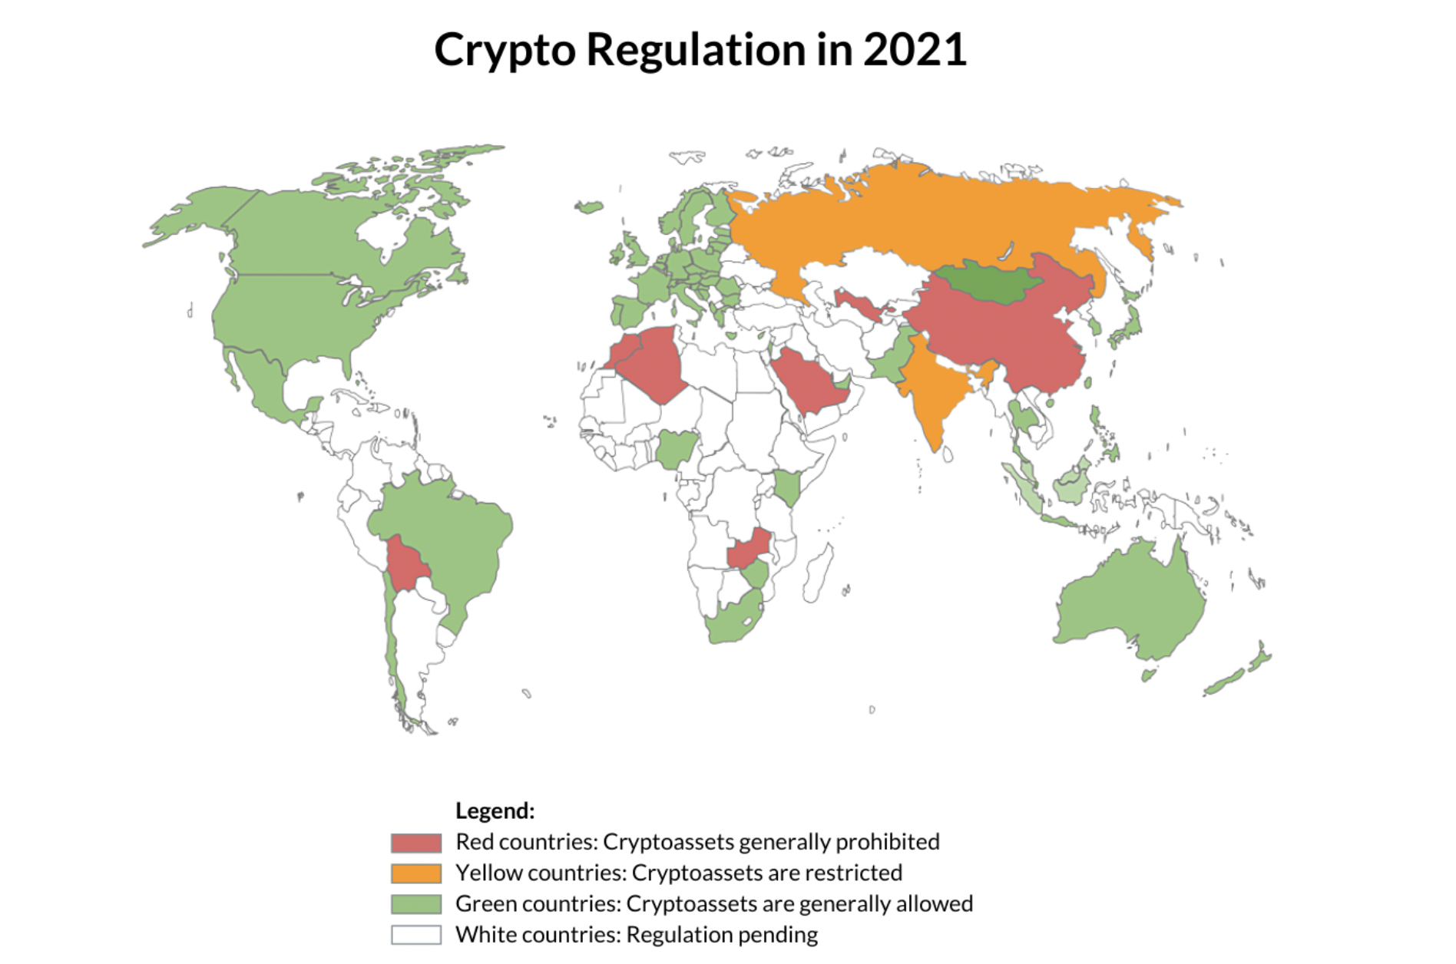
Data
Small dataset
Sequential data
Relevance of previous informations
High variance
Feature engineering
Politics/Economics/Regulations/Environment

Slide 4
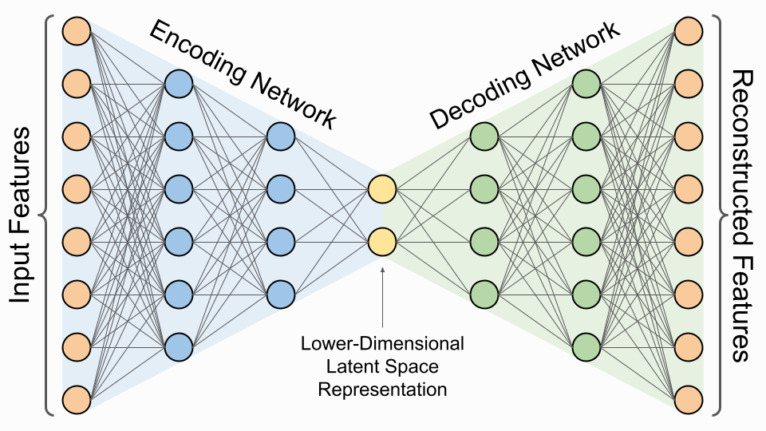
Architecture
Encoder-Decoder
End-to-End
Latent Space Representation
Encode sequence into fixed-length vector
Decode into another sequence
Unsupervised to Supervised

Slide 5
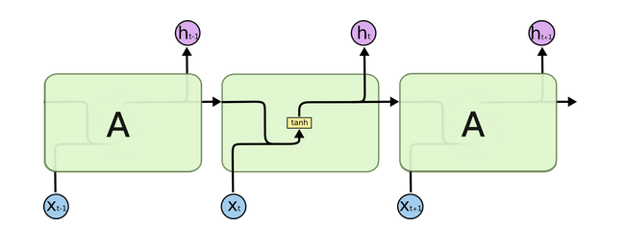
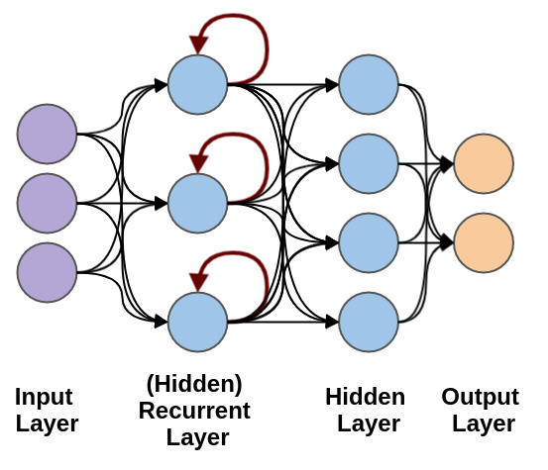
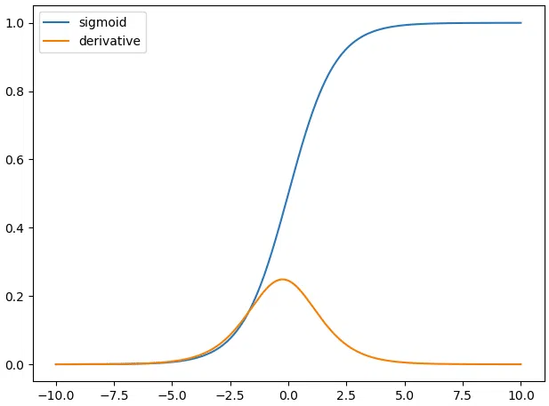
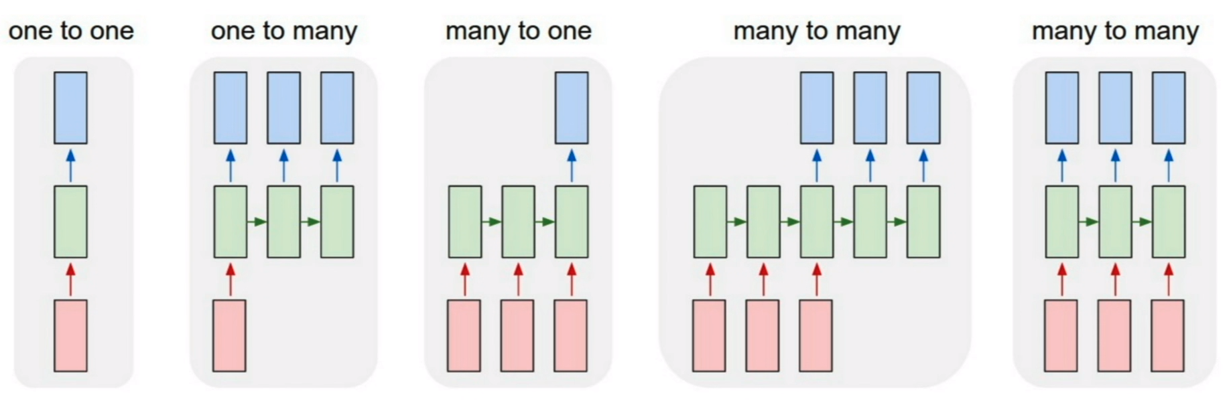
Network _{#1}
Recurrent Neural Network (RNN)
Temporal dynamics
Hidden states, Loops
Long dependencies
Sequence Modeling
Back-propagation through time (BPTT)

Slide 6
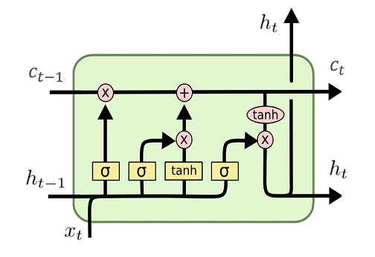
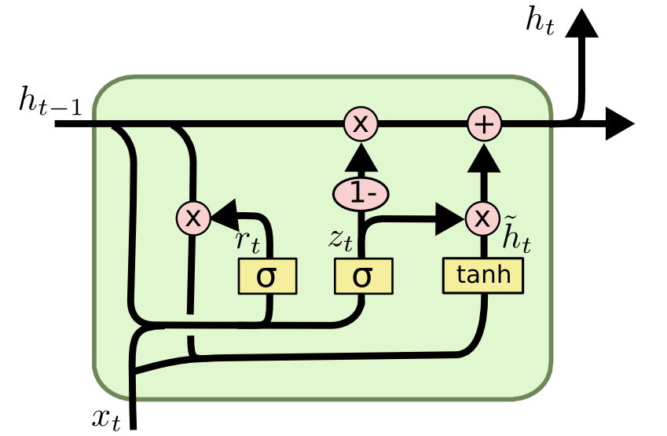
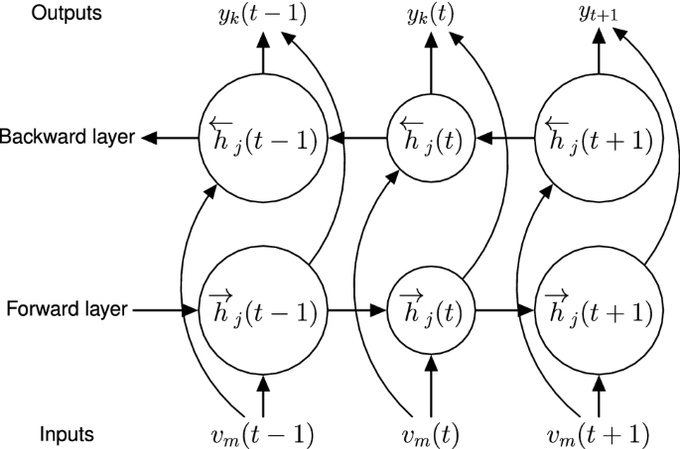
Network _{#2}
Gated Recurrent Unit (GRU)
Simplified Long-Short Term Memory (LSTM)
Internal states (reset gate, update gate)
No cell state
Few tensor operations
Bidirectional RNN
LSTM
GRU

Slide 7
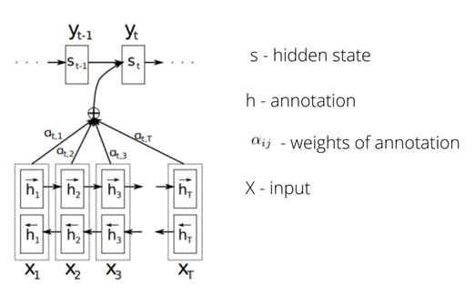
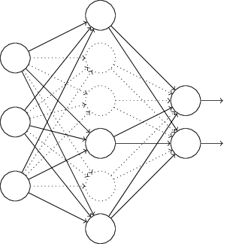
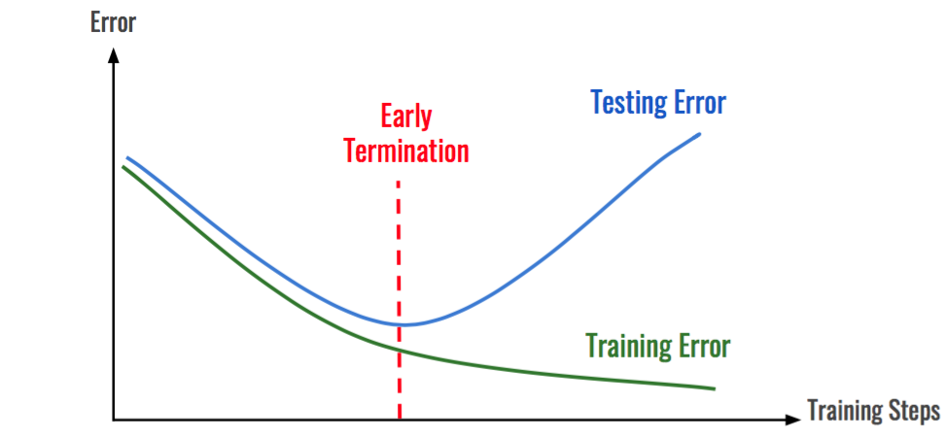
Network _{#3}
Attention!
Summary as bottleneck
Alignment score
Regularization
Dropout
Weight decay
Noise injection
Early stopping

Slide 8
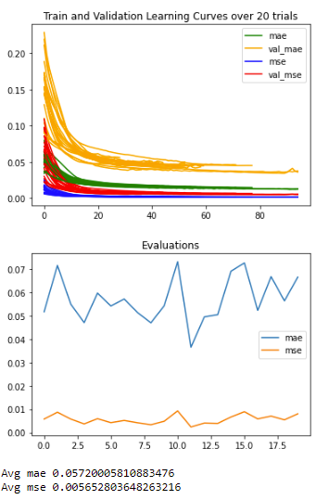
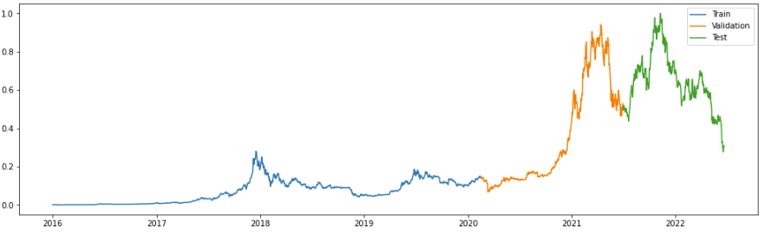
Issues
Small dataset
Exponential-like distribution
Recent price oscillations
Early years samples not relevant

Slide 9
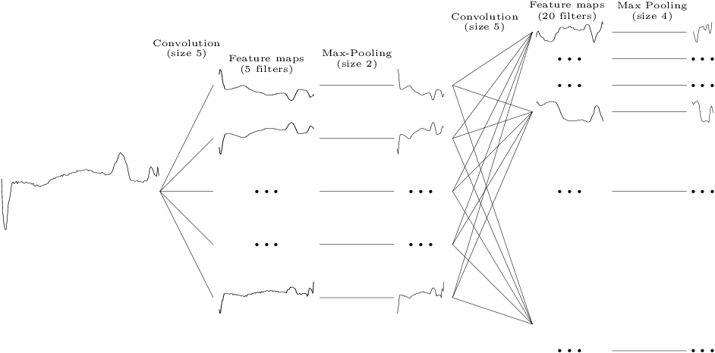
Future
Feature engineering
Different data augmentation
Convolutional Neural Network (CNN)
Autoregressive models
…
More tuning!

Slide 10

Thank you for your attention!

